Slide 1
improvement of noise reduction of Knee Joint Vibroarthrographic(VAG) Signals By analyzing different filtering methods
Thasin abedin
Id:160021139
Section: c 2

Slide 2
Definition:
Vibro arthro graphy (VAG) is the recording of vibrations or acoustic signals from the human knee joint during active movement of the leg and can be used as a noninvasive diagnostic tool to detect articular cartilage degeneration.
Economical choice in terms of cost and time with respect to other diagnostic methods like CT scans, MRI for knee joint disorder
Part of biomedical domain diagnostic tool with the help of signals
PROBLEMS ASSOCIATED WITH VAG SIGNALS:
For diagonosation, we need to extract the vibration signals from the knee and the time-frequency analysis of these signals is done.
This task can become complicated when quality is degraded due to interferences from noises in VAG signal
One significant noise causing this problem is the existence of ‘Baseline Drift’ in VAG signal
As a result, removal/reduction of noises is mandatory in VAG signal for correct diagnosis
RELEVANT RESOURCE:
http://www.idosi.org/mejsr/mejsr20(12)14/139.pdf

Slide 3
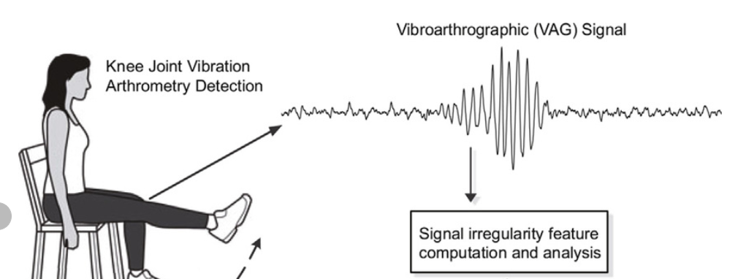
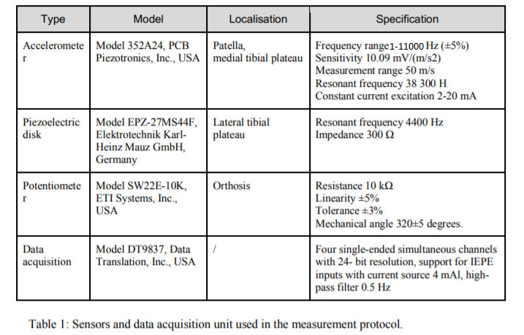
DATA ACQUISATION
To collect data accelerometers are attached to the patient’s skin
The accelerometers were positioned such that the sensors detected the VAG signal, while the or acoustic signals from the human knee joint during remainder monitored variations in the signal along the leg
PARAMETERS:
For this lab, I chose the patella and tibial plateau region signal information of the knee joint
From the resource given in a paper, I took the frequency (11000 Hz) given in the accelerometer specification
Sampling frequency taken = 48000 Hz

Slide 4
WHY is fir not a good choice for our task?
FIR Filters cannot implement analog filter responses
Our biomedical accelerometer records analog signals from knee joint during the movement of the knee joint
Under such cases, FIR filters will not be a good choice to deal with real life analog signals
What is the solution?
- USE IIR FILTERS

Slide 5
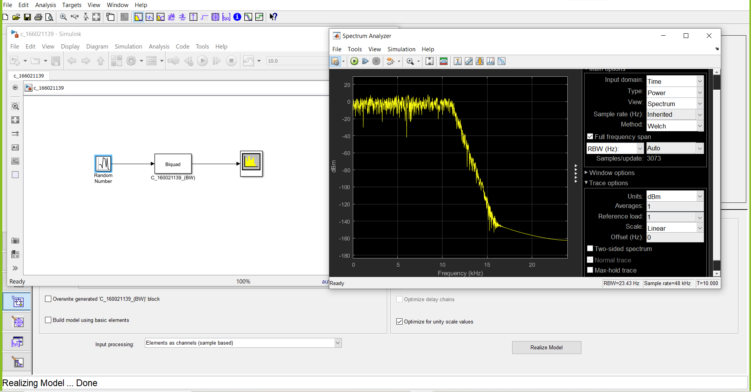
Proposed Solution
To extract the very low frequency VAG signals, we firstly implemented the Butterworth Filter with an order of 25
OBSERVATION:
In this design, there is much interference due to noise in the transition band. The curve is not smooth enough. But for accurate diagnosis, we need to eliminate/reduce the noises as much as possible. So this design has plenty of scope for improvement.
Fig: Characteristics Curve

Slide 6
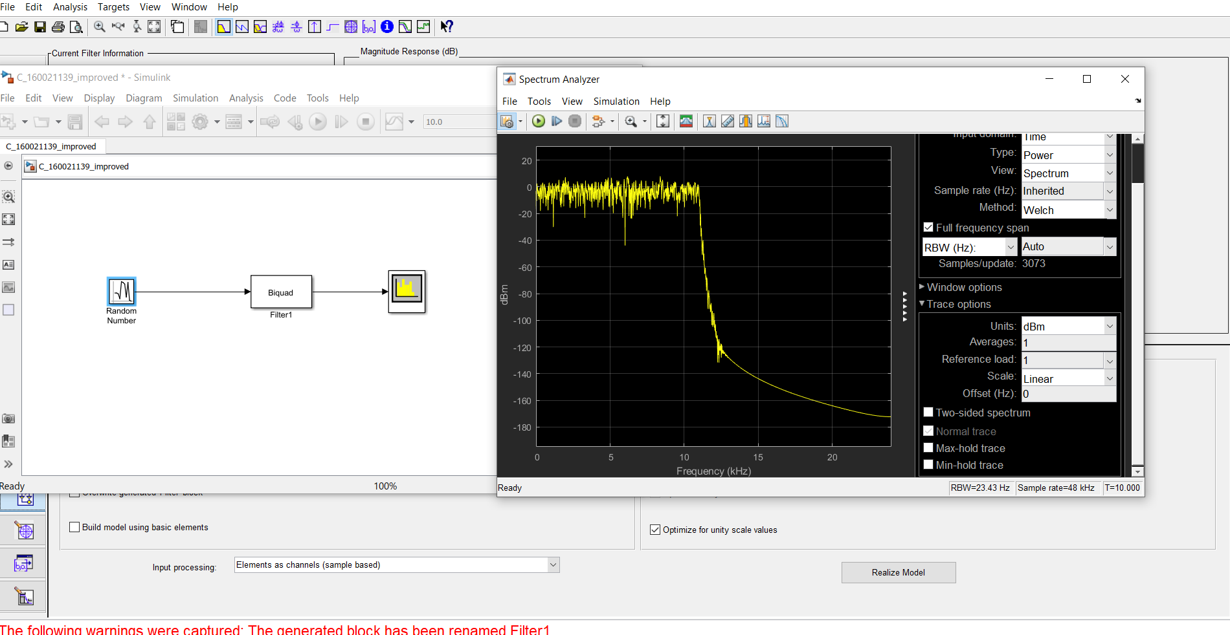
Improvement of noise reduction
For improvement in performance, I used Chebyshev Type -1 replacing Butterworth Filter for the same task
Filter order = 25
The characteristic curve became much smooth and noise was drastically reduced which made it more suitable for diagnosis
OBSERVATION:
We can clearly see that our result become much better. The Chebyshev Type – 1 filter manged to eliminate the noise far better and make it suitable to extract the VAG signal with low frequency. Another important fact is, as the order of the filter was increased, we could eliminate more and more noise.
Fig: Improved Characteristics Curve

Slide 7
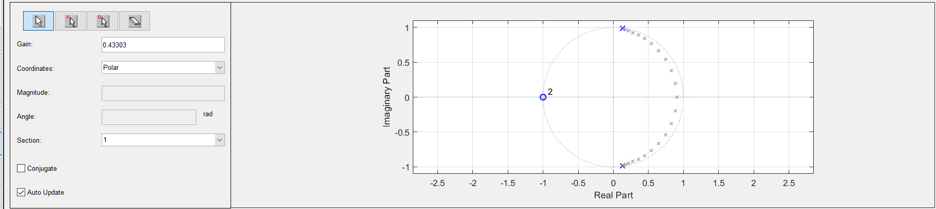
CONcluding remarks:
DESIGN EFFICIENCY: Even with the same order, the Chebyshev Type – 1 filter outperformed the Butterworth Filter and improves the performance
STABILITY: The improved filter response is stable as all the poles are in the right half plane
COMPLEXITY: As the order of the filter is increased, even though the performance becomes more better, the complexity of the filter also increases
Fig: Stability
COST: The more the complexity of the filter increases, the more the cost increases. So there is a trade-off involved between the cost and performance of the filter which needs to e balanced according to the need
ADDED ADVANTAGE OF OUR DIAGNOSIS DESIGN OVER OTHER EXISTING METHODS:
Less cost and time needed compared to CT scans and MRI
Helps in early detection of cartilage degeneration, not possible by most other methods
Amongst the VAG signal extraction methods, the Chebyshev filter implementation performs the best compared to other existing methods like Chebyshev filters, Adaptive Filter Method etc

